Slide 1

A2Z CORPORATION: SECURE NETWORK DEFENSE ARCHITECTURE
NAME: PATRICK ROGERS
STUDENT ID: SCSJ2100424

Slide 2
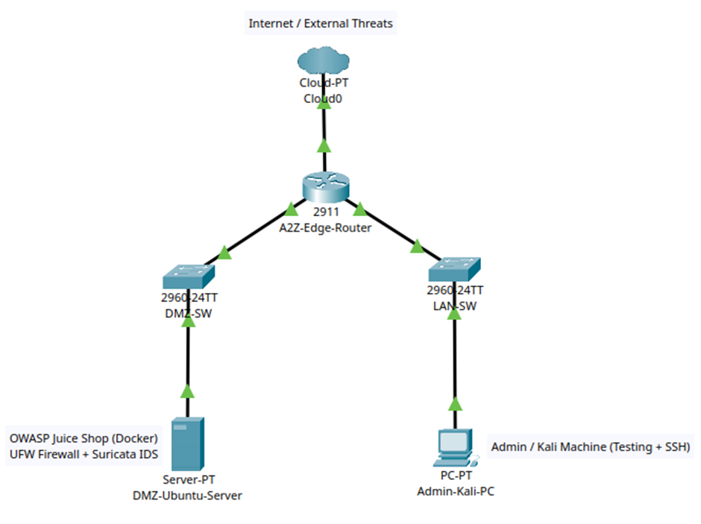
SYSTEM DESIGN
KEY ARCHITECTURAL FEATURES
Purpose: Mitigate risks like external attacks and lateral movement by isolating network segments.
  Demilitarized Zone (DMZ): Hosts the public-facing service (Ubuntu Server/Juice Shop).
  Internal LAN: Protected segment for administrative systems (Admin-Kali-PC).
  Control: A2Z-Edge-Router manages traffic flow and enforces strict isolation policies.
This structure prevents direct access to internal assets from the internet.

Slide 3
IMPLEMENTED SECURITY MEASURES: UFW FIREWALL
HOST-LEVEL ACCESS CONTROL
Default Policy: Deny ALL incoming traffic.
Allowed Ports: Explicitly enabled only 80, 443, 3000.
SSH Restriction: Port 22 is restricted solely to the trusted Admin-Kali-PC IP (192.168.20.10).
Function: Acts as the first line of defense, strictly controlling network traffic and minimizing the server's attack surface against brute-force and exploitation attempts.

Slide 4
IMPLEMENTED SECURITY MEASURES: DOCKER
APPLICATION ISOLATION AND CONTAINMENT
Application: OWASP Juice Shop deployed in a Docker container (exposed on port 3000).
Security Benefit: Isolation. Contains potential breaches within the container, preventing attackers from gaining root access to the host OS or moving laterally.
Resilience: Malicious changes are non-persistent and automatically erased when the container is restarted.

Slide 5
IMPLEMENTED SECURITY MEASURES: SURICATA IDS
REAL-TIME THREAT DETECTION
Deployment: Installed and configured to monitor the DMZ interface (enp0s8).
Detection Capability:
  Identifies port scans (like Nmap).
  Brute-force attempts.
Role: Provides continuous monitoring and early warning, detecting threats that bypass the host-level firewall.

Slide 6


SECURITY TESTING & VALIDATION
NMAP SCANNING
SURICATA IDS ALERTS
Method: Simulated an external attacker to confirm firewall rules and network mapping.
Method: Monitored IDS logs during the Nmap simulation.
Result: Only expected ports (80, 3000) were open. Services were successfully enumerated, confirming visibility controls.
Result: 78 alerts generated. The IDS is fully functional in real-time detection mode.

Slide 7
CONCLUSION
PROJECT SUMMARY: ENHANCED SECURITY POSTURE
A secure, layered infrastructure was successfully designed, implemented, and validated for A2Z Corporation. Key outcomes include:
  Reduced Attack Surface (UFW + DMZ segmentation).
  Isolated Vulnerable Services (Docker containerization).
  Continuous Threat Detection (Suricata IDS).
The system is now more resilient and secure against key external threats, providing enhanced operational continuity.

Slide 8
THANK YOU

